Slide 1
INTRO to

Slide 2
What is Scraping?
Web scraping is the process of automatically collecting information from the World Wide Web
We all have done it somehow, but copy & paste is not so efficient..
Notes:
In every day data science and data mining web scraping is a common technique to to collect information from the Internet. Let's face it we all have done it somehow, but copy & paste is not so efficient... There are a couple of free tools to create a databases from online texts, such as import.io, but today we are going to learn how to do with Python using the HTML code of a website.

Slide 3
How does the Internet work?
Notes:
The first thing you need to understand is that a website consists of a bunch of files saved on a hard disk. Just like your movies, music, or pictures
. However, there is one part that is unique for websites: they include computer code called HTML.
As with every file, we need to store HTML files somewhere on a hard disk.
For the Internet, we use special, powerful computers called servers. They don't have a screen, mouse or a keyboard, because their main purpose is to store data and serve it.
That's why they're called servers – because they serve you data.
Looks like a mess, right? In fact it is a network of connected machines (the above-mentioned servers). Hundreds of thousands of machines! Many, many kilometers of cables around the world! You can visit a Submarine Cable Map website (http://submarinecablemap.com
But it is not possible to have a wire between every machine connected to the Internet. So, to reach a machine (for example, the one where https://djangogirls.org is saved) we need to pass a request through many, many different machines.

Slide 4
What is a link?
A hyperlink, or simply a link, is a reference to data that the reader can directly follow either by clicking, tapping, or hovering. A hyperlink points to a whole document or to a specific element within a document.
Why is it useful?

Slide 5
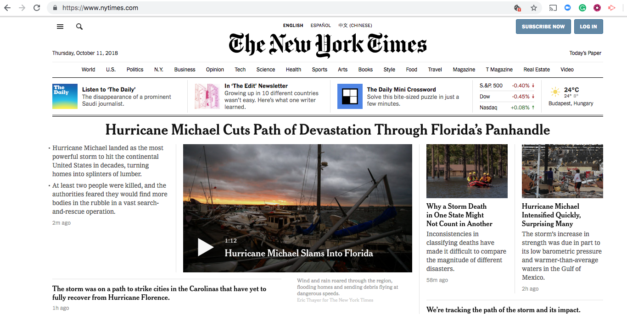

Slide 6
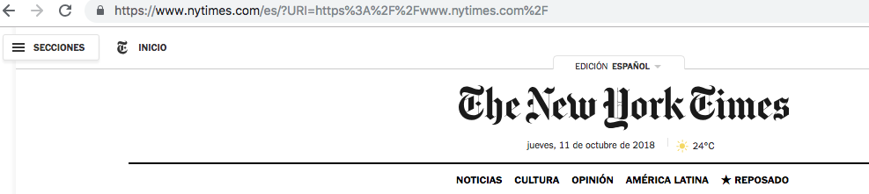

What is that?

Slide 7
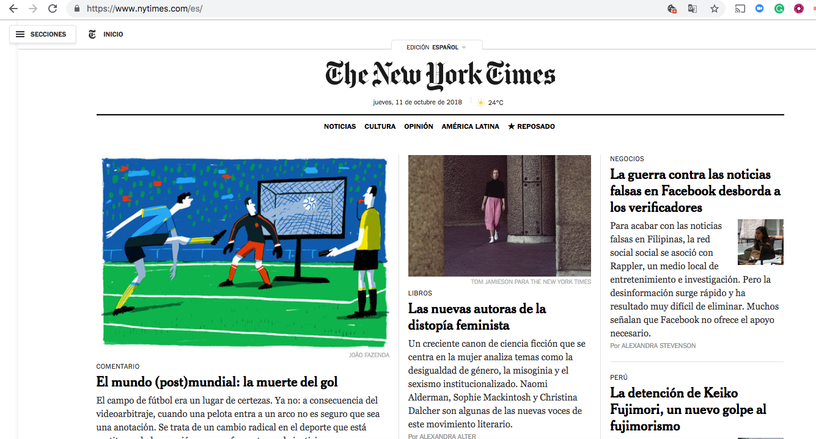
It redirects you to the same place…

Slide 8
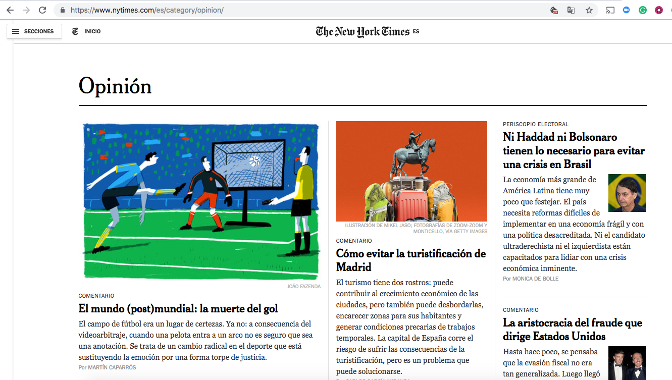

Slide 9
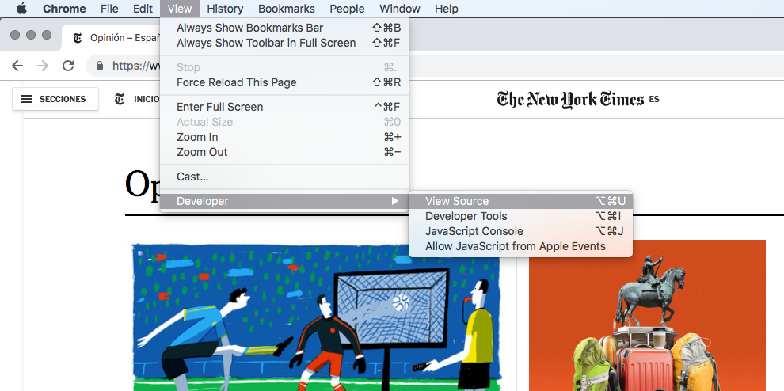

Slide 11
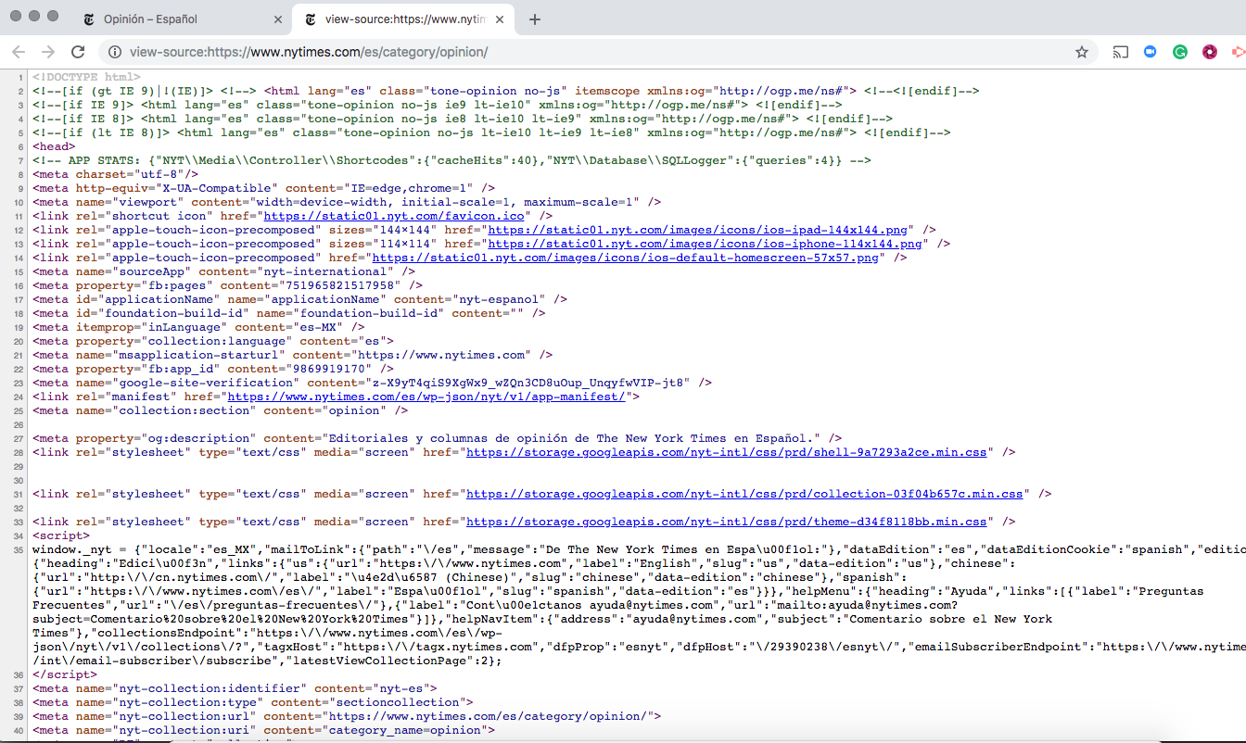

Slide 12
What is HTML?
HTML stands for "HyperText Markup Language".
HyperText means it's a type of text that supports hyperlinks between pages.
Markup means we have taken a document and marked it up with code to tell something (in this case, a browser) how to interpret the page.
HTML code is built with tags, each one starting with < and ending with >. These tags represent markup elements.
Notes:
The most basic tag, <html>, is always the beginning of any webpage and </html> is always the end. As you can see, the whole content of the website goes between the beginning tag <html> and closing tag </html> * <p> is a tag for paragraph elements; </p> closes each paragraph Each HTML page is also divided into two elements: head and body.
* head is an element that contains information about the document that is not displayed on the screen. * body is an element that contains everything else that is displayed as part of the web page. We use <head> to tell the browser about the configuration of the page, and <body> to tell it what is actually on the page. And this body part is the important for us, when we want to extact information from a site. The HTML code such as python code is a structured text file whith different tags telling where to put what on the website.
As you can see tag helps to navigate through the website, and that is what we use when we decide which part of the html file we would like to store as a variable.

Slide 13
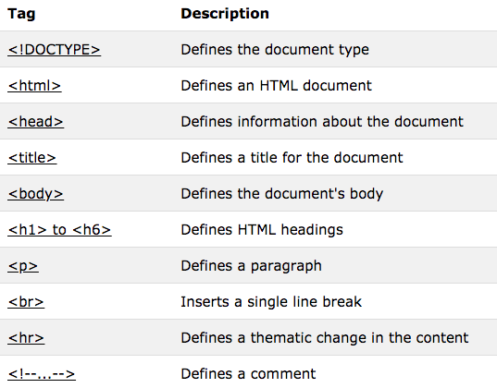
Most important HTML tags
Notes:
The most basic tag, <html>, is always the beginning of any webpage and </html> is always the end. As you can see, the whole content of the website goes between the beginning tag <html> and closing tag </html> * <p> is a tag for paragraph elements; </p> closes each paragraph Each HTML page is also divided into two elements: head and body.
* head is an element that contains information about the document that is not displayed on the screen. * body is an element that contains everything else that is displayed as part of the web page. We use <head> to tell the browser about the configuration of the page, and <body> to tell it what is actually on the page. And this body part is the important for us, when we want to extact information from a site. The HTML code such as python code is a structured text file whith different tags telling where to put what on the website.
As you can see tag helps to navigate through the website, and that is what we use when we decide which part of the html file we would like to store as a variable.

Slide 14
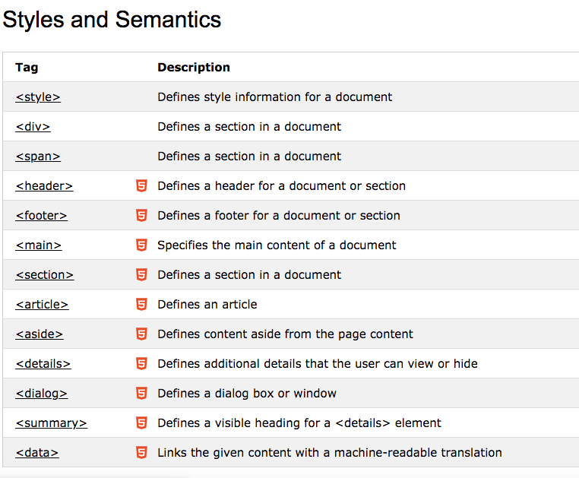
More styling elements here

Slide 15
Tag helps to navigate through the website, and that is what we use when we decide which part of the html file we would like to store. Let’s see an example!

Slide 16
More about scraping..
https://github.com/velf/Data_Analysis_with_Python/blob/master/Lecture2/
https://tutorial.djangogirls.org/en/how_the_internet_works/
https://www.analyticsvidhya.com/blog/2015/10/beginner-guide-web-scraping-beautiful-soup-python/
https://towardsdatascience.com/an-introduction-to-web-scraping-with-python-bc9563fe8860

